Slide 1
Professor Julie Shubin, Esq.
.
Bule 303 Intro to the Law 2018©

Slide 2
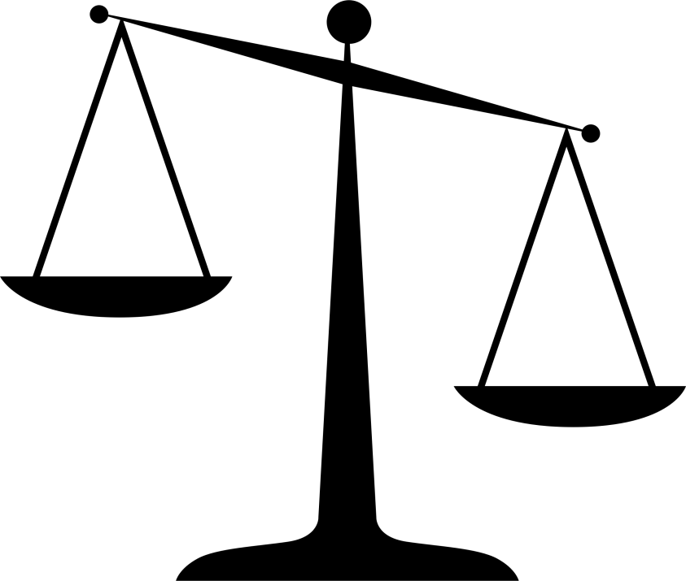
The law and business
The law impacts every-day business transactions.
Many different laws may affect a single business transaction.

Slide 3
Sources of American Law
Constitutional Law
Statutory Law
Administrative Law
Case Law and
Common Law Doctrines

Slide 4
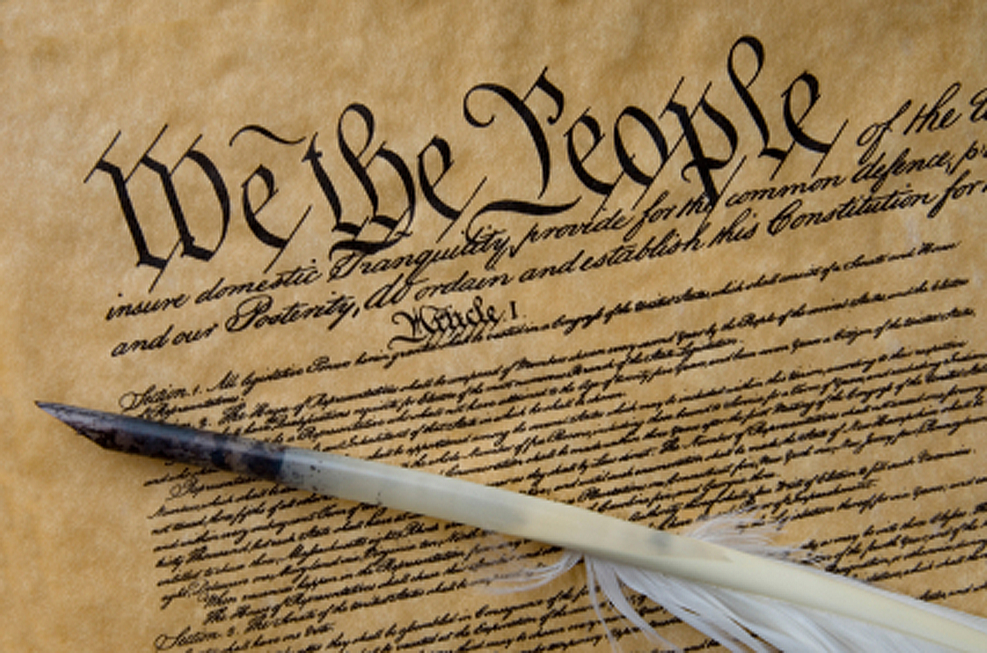

Slide 5
Constitutional Law
The law as expressed in the U.S. Constitution and the various state constitutions.
The U.S. Constitution is the supreme law of the land.
State constitutions are supreme within state borders to the extent that they do not violate the U.S. Constitution or a federal law.
Notes:
First Monday in October

Slide 6
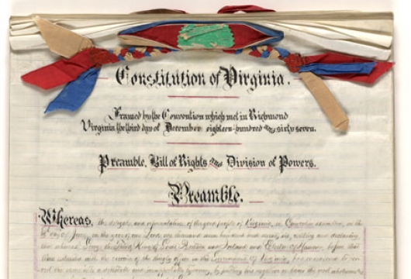

Slide 7
Constitution of Virginia
A declaration of rights made by the good people of Virginia in the exercise of the sovereign power, which rights do pertain to them and to their posterity, as the basis and foundation of government
legis.state.va.us/laws/search/constitution.htm

Slide 8
Statutory Law
Laws or ordinances created by federal, state, and local legislatures and governing bodies.
None of these laws can violate the U.S. Constitution or the relevant state constitutions.
Uniform laws, when adopted by a state legislature, become statutory law in that state.

Slide 9
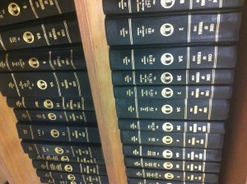

Slide 10
Code of Virginia
https://leg1.state.va.us/000/src.htm

Slide 11



Administrative Law
The rules, orders, regulations, and decisions of federal, state, or local government administrative agencies.
Federal administrative agencies are created by enabling legislation enacted by the U.S. Congress.

Slide 12

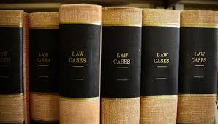
Case Law and Common Law Doctrines
Judge-made law, including interpretations of constitutional provisions, of statutes enacted by legislatures, and of regulations created by administrative agencies.
The common law, the doctrines and principles embodied in case law, governs all areas not covered by statutory law or agency regulations issued to implement various statutes.

Slide 13
Common law
England
Law from decisions and customs
Not legislation

Slide 14
Important concepts
Stare decisis “To stand on decided cases”
Precedent (see next slide)
Binding authority
Case of first impression
Persuasive authority
Finders Keepers

Slide 15
Show me the money? The land? The ___?
Remedies at law:
  Money, property, land or something else
  of value.
Remedies in equity:
  Remedies that are granted when the remedies at law are unavailable or inadequate.

Slide 16
Other terms you should learn—check out your textbook
  Plaintiff
  Defendant
  Jurisprudence
  Statute of Limitations
  Civil law
  Criminal law

